Slide 1
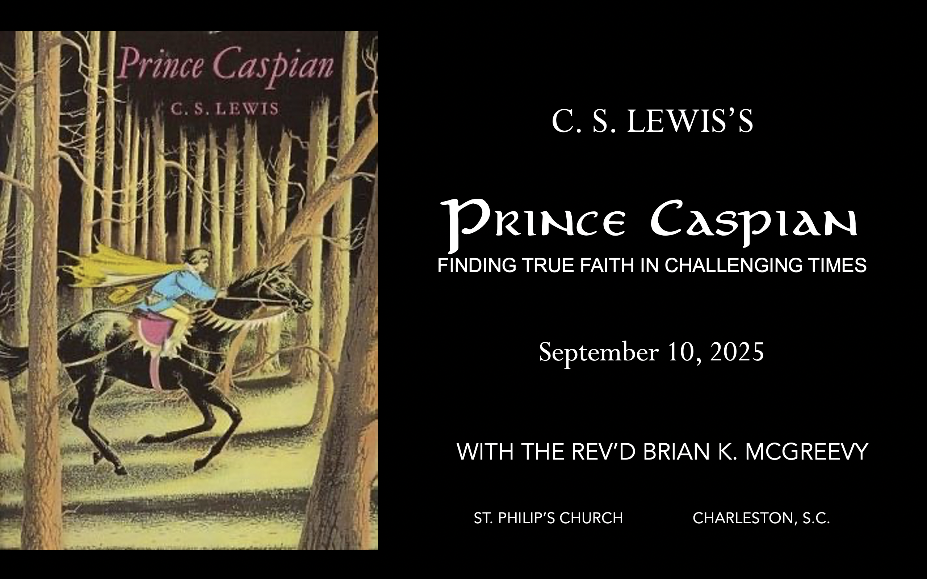

Slide 2

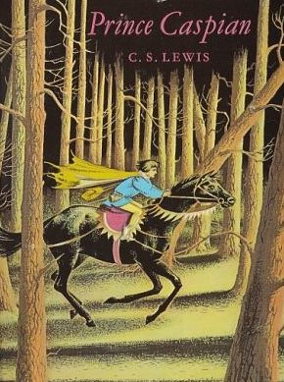
How to approach this class: How to approach this class:
--On the beach --Snorkeling --Scuba diving --Email list/QR code How to read this book: --Try reading aloud and slowly, looking for layers of meaning
--Look for themes/underline and highlight passages that resonate with you
What we’ll be doing:
--Setting the background and context
--Following the story chapter by chapter
--Drawing out principles for living with Joy and Purpose
--Looking at relevant Scripture

Slide 3
For you were once darkness, but now you are light in the Lord. Live as children of light (for the fruit of the light consists in all goodness, righteousness, and truth), and find out what pleases the Lord.
Have nothing to do with the fruitless deeds of darkness, but rather expose them. It is shameful even to mention what the disobedient do in secret. But everything exposed by the light becomes visible—and everything that is illuminated becomes a light. This is why it is said: “Wake up, sleeper, rise from the dead, and Christ will shine on you.” Be very careful, then, how you live— not as unwise but as wise, making the most of every opportunity because the days are evil.
Ephesians 5:8-15

Slide 4
Why Lewis? The most unlikely Christian --painful and dysfunctional childhood --despair and bitterness after World War I --brilliant, proud, and aggressive atheism --worldly success Sehnsucht The impact of a bold friend and the formation of the Inklings “The most thoroughly converted man”
--scholar, teacher, author, friend, mentor --worldview --authenticity --humility --gift for analogy and for story --heart after God --Joy

Slide 5
The Chronicles of Narnia: Such a Gift! More popular than ever—huge Netflix deal announced
Record interest in Lewis, Tolkien and the Inklings Films have grossed more than $500 million Over 100 million copies sold in 47 languages The Lion, the Witch, and the Wardrobe voted the best English children’s story of all time (Waterstone’s) The Last Battle was awarded the Carnegie Award, the highest award for children’s literature Written in a very brief period of time:
The Lion, the Witch and the Wardrobe (1950) Prince Caspian (1951) The Voyage of the Dawn Treader (1952) The Silver Chair (1953) The Horse and His Boy (1954) The Magician's Nephew (1955) The Last Battle (1956) The Narnia Code—the seven planets of the Medieval cosmology

Slide 6
The Origins of Narnia
Meanwhile in his spare time…
The Personal Heresy: A Controversy (1939)
The Problem of Pain (1940)
The Case for Christianity (1942)
A Preface to Paradise Lost (1942)
Broadcast Talks (1942)
The Abolition of Man (1943)
Christian Behaviour (1943)
Beyond Personality (1944)
Perelandra (1943)
That Hideous Strength (1945)
The Screwtape Letters (1942)
The Great Divorce (1945)
Miracles: A Preliminary Study (1947)
Arthurian Torso (1948)
Transposition, and Other Addresses (1949)
English Literature in the Sixteenth Century Excluding Drama (1954)

Slide 7
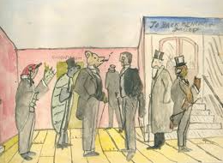
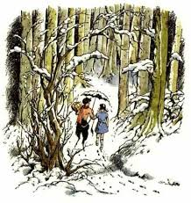
The Origins of Narnia
1907—Lewis (age 9) writes to his brother Warnie that he is writing and illustrating “A History of Mouse-land,” which is eventually combined with Warnie’s love of India to form the imaginary realm of Boxen, whose main characters are dressed and talking animals. Lewis developed a history of Boxen and a political structure for it in his early teens. 1914—The image of a Faun carrying an umbrella and parcels in a snowy wood came to Lewis’s imagination when he was 16, and he made a sketch of it which continued to reappear in his memory over the next decades. 1939—On September 2, the day before Britain declares war on Germany, four evacuee children arrived at Lewis’s home, the Kilns, the first of various groups of children Lewis will house continually through the war up through
1945--Around this time, Lewis begins a story, later set aside, about four evacuee children from London sent to stay with an old professor. Surprised to find how few imaginative stories his young guests seemed to know, he decided to write one for them and scribbled down the opening sentences of a story about four children—then named Ann, Martin, Rose and Peter—who were sent away from London because of the air raids, and went to stay with a very old professor who lived by himself in the country.

Slide 8
The Origins of Narnia
1947—“All my seven Narnian books began with seeing pictures in my head. The Lion, the Witch, and the Wardrobe began with a picture of a Faun carrying an umbrella and parcels in a snowy wood. This picture had been in my mind since I was about sixteen. Then one day, when I was about forty, I said to myself: ‘Let's try to make a story about it.’ At first I had very little idea how the story would go. But then suddenly Aslan came bounding into it. I think I had been having a good many dreams of lions about that time. Once He was there He pulled the whole story together.”—Radio Times interview, 1960 1954--“I did not say to myself ‘Let us represent Jesus as He really is in our world by a Lion in Narnia’: I said ‘Let us suppose that there were a land like Narnia and that the Son of God, as He became a Man in our world, became a Lion there, and then imagine what would happen.” --letter to a fifth grade class in Maryland Lewis was passionate in his views about children’s stories: “A children's story that can only be enjoyed by children is not a good children's story in the slightest.” “No book is really worth reading at the age of ten which is not equally – and often far more – worth reading at the age of fifty and beyond.”

Slide 9
Why Narnia matters SO much today Aggressively secular narrative pervading our culture—how to counter?
Which Story Can We Trust? Either
We are here by accident, meaningless products of a random process. We create our own identity and can only invent meaning and purpose in life and do our best to stay alive—even though there is no point to life. Sartre, Dawkins, Nietzsche, most schools OR
We are precious creatures made by and in the image of a loving God, who has created us for something special that we are asked to do. We have the privilege of being able to do good and experience purpose as we live by faith in Christ in His Kingdom. The witness of Scripture, the Church, and the saints
These two stories are totally incompatible. They can’t both be right: cognitive dissonance. So which do we trust? Other stories, like the Chronicles of Narnia, can help us here by highlighting dissonance or by creating a narrative we want to inhabit. So which do we trust? Is Jadis really the Queen of the realm of Queen Narnia? OR Is she the White Witch, a usurper in Narnia, which is really the realm of the mysterious great and noble lion, Aslan? Gradually, one story about Narnia emerges as supremely plausible, as each individual story turns out to be part of this greater narrative. This grand narrative of interlocking stories makes sense of the riddles the children see and experience and reveals the character of each narrative. These stories teach that Biblical truth and the wisdom of the world cannot both be True---we need to learn to think critically because we are surrounded by falsehood.
We each have our unique story. But our own story needs to be brought into connection with a grand narrative, a big story which gives our story a new importance and significance. Why? Because we realize that our story is framed by something greater which gives us value and purpose. Lewis’s remarkable achievement in Narnia is to allow his readers to inhabit this big story, to get inside it and feel what it is like to be part of it. --Rev. Dr. Alister McGrath, Holder of the Andreas Idreos Chair in Science and Religion, Oxford University (Ph.D. in Molecular Biophysics, Doctor of Divinity in Theology, and Ph.D. in Intellectual History, at Oxford)

Slide 10
Why Prince Caspian is especially relevant today
Imagine living in a land
--that had forgotten its history and substituted a revisionist narrative that said all evidences of the Divine were foolish myths,
--where individuals struggled to practice their faith while being surrounded by a sea of doubters and skeptics,
--where Evil seemed poised to triumph over Good, and
-- where even the strongest believers wondered sometimes whether they had been abandoned.
Welcome to the world of Prince Caspian, the next book of the Chronicles of Narnia after The Lion, the Witch, and the Wardrobe. C.S. Lewis wrote that this book concerns the “restoration of the true religion after a corruption.
We will be examining such themes as
--how disbelief and doubt creep into our lives,
--the effects of living under the wrong framework of reality,
--the importance of cultivating virtue and courage, and
--the priority of seeking the Kingdom of God with our whole heart.

Slide 11
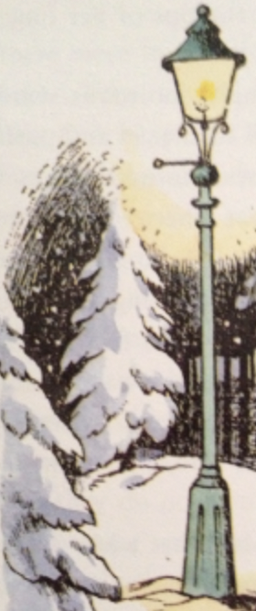
Plot Summary of The Lion, the Witch, and the Wardrobe
--Peter, Susan, Edmund, and Lucy go to live with the old professor during WW2
--Lucy finds a magic wardrobe and enters Narnia and becomes friends with Tumnus the Faun, learning about the White Witch and “always Winter, never Christmas”
--Edmund taunts Lucy but soon enters Narnia on his own, meeting the White Witch and feasting on her enchanted Turkish Delight
--All four children enter Narnia and are told by the Beavers about the prophecy
--Edmund leaves the Beavers and goes to the White Witch, while the others set out to find Aslan.
--Aslan eventually rescues Edmund, but the White Witch demands Edmund’s blood
--Aslan sacrifices himself on the Stone Table, allowing the Witch to kill him in order to save Edmund
--The Stone Table cracks and Aslan is resurrecte—he seeks to defeat the Witch and her minions in battle.
--Aslan and his forces defeat the White Witch, with Edmund making a major contribution to the victory and getting seriously wounded in the process.
--Lucy’s cordial brings healing to Edmund, and after a day to relax, Peter, Edmund, Susan, and Lucy are crowned and enthroned at Cair Paravel in a solemn and glorious ceremony, capped off with feasting and music and dancing.
--Though Aslan disappears from their midst, the new Kings and Queens rule benevolently over Narnia for many years.
--Following a report that the White Stag has reappeared in Narnia, the Kings and Queens go on a hunt and the Stag leads them to a thicket, through which they find their way to the Wardrobe and back into the Professor’s house, where they find themselves children again.
--The Professor tells them they can’t force their way back to Narnia, but it may happen when they least expect it.

Slide 12

The next book in the Narnia series was written in 1949 and completed even before The Lion, the Witch, and the Wardrobe was actually published. Lewis entitled the book Prince Caspian: The Return to Narnia, and it was published in 1951.
Lewis dedicated the book to Mary Clare Havard. She was one of the five children of Dr. Robert Emlyn “Humphrey” Havard, who was one of the Inklings and a great friend of both Lewis brothers. Dr. Havard was their family physician and his intellect and skill led Lewis to request his assistance with his book The Problem of Pain, for which Havard wrote an appendix. Dr. Havard was also one of the witnesses of Lewis’ civil marriage to Joy Davidman. The character Humphrey in Perelandra is named after one of Dr. Havard’s many nicknames, which included “U.Q” (Useless Quack).
Several sources indicate Lewis gave an early manuscript of The Lion, the Witch, and the Wardrobe to Mary Clare around 1948, when she would have been 11 or 12, and she told him she liked it very much. As an adult, she brought up her own children on Narnia.

Slide 13
Order, Setting, and Overall Theme
The second in the series, written in late 1949
Published in 1951
Illustrated by Pauline Baynes
Set in England in 1941, fourteen months after they first went to Narnia
In Narnia time it is 1,300 years after The Lion, the Witch and the Wardrobe
Lewis said the book was about “restoration of the true religion after a corruption”
Publication order—THE CORRECT order in which to read the Chronicles!
The Lion, the Witch and the Wardrobe (1950) Prince Caspian (1951) The Voyage of the Dawn Treader (1952) The Silver Chair (1953) The Horse and His Boy (1954) The Magician's Nephew (1955) The Last Battle (1956)

Slide 14
Some Quotations to Whet Your Appetite
“You come of the Lord Adam and the Lady Eve,” said Aslan. “And that is both honour enough to erect the head of the poorest beggar, and shame enough to bow the shoulders of the greatest emperor on earth. Be content.”
“You have listened to fears, Child,' said Aslan. 'Come, let me breathe on you. Forget them. Are you brave again?”
“Wouldn’t it be dreadful if some day in our own world, at home, men started going wild inside, like the animals here, and still looked like men, so that you’d never know which were which?”
“Welcome, Prince,’ said Aslan. ‘Do you feel yourself sufficient to take up the Kingship of Narnia?’ ‘I – I don’t think I do, Sir,’ said Caspian. ‘I am only a kid.’ Good,’ said Aslan. ‘If you had felt yourself sufficient, it would have been proof that you were not.”
“Aslan" said Lucy "you're bigger". "That is because you are older, little one" answered he. "Not because you are?" "I am not. But every year you grow, you will find me bigger.”

Slide 15
HE WHO WOULD VALIANT BE
He who would val­iant be ’gainst all dis­as­ter, Let him in con­stan­cy fol­low the Mas­ter. There’s no dis­cour­age­ment shall make him once re­lent His first avowed intent to be a pil­grim.
Who so be­set him round with dis­mal sto­ries Do but them­selves con­found—his strength the more is. No foes shall stay his might; though he with gi­ants fight, He will make good his right to be a pil­grim.
Since, Lord, Thou dost de­fend us with Thy Spir­it, We know we at the end, shall life in­herit. Then fan­cies flee away! I’ll fear not what men say, I’ll la­bor night and day to be a pil­grim.
Text: John Bunyan
Music: Monks Gate, traditional Susssex tune
Arranged by Ralph Vaughan Williams, 1904

